Slide 1


Python for all of us
Bama S
Department of Information Science and Technology, CEG Campus
Anna University, Chennai – 600 025
Presentation for STEMM Program sponsored by DST
DMI College of Engineering, Chennai
27 August 2022

Slide 2
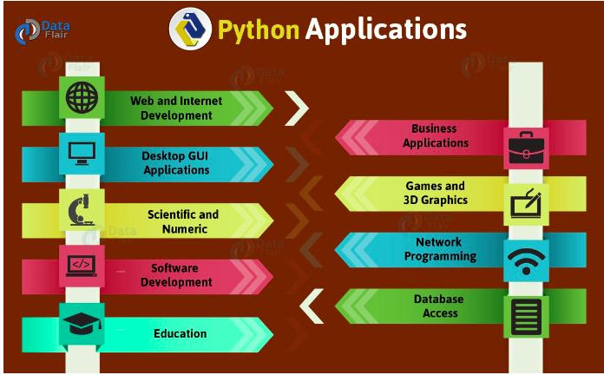
https://medium.com/@patelharshali136/9-real-world-application-of-python-80f0067ea8c5

Slide 3

https://realpython.com/world-class-companies-using-python/

Slide 4

Get Started with Turtle game
https://hourofpython.trinket.io/a-visual-introduction-to-python#/welcome/an-hour-of-code

Slide 5

Programming with Python
Variables
Strings
Lists
Dictionary
If – then – else
Loops
Functions
https://github.com/Bama-S/python_intro

Slide 6

Programming examples that can be tried
Square of a number
Sum of 1st n numbers
Factorial of n numbers
Quadratic equation

Slide 7
Links
Programiz -Online Python Compiler (Interpreter) (programiz.com)
OnlineGDB -Online Python Compiler - online editor (onlinegdb.com)
Replit - Python Online Compiler & Interpreter - Replit
Learn Python – Free Python Courses for Beginners (freecodecamp.org)
https://www.w3schools.com/python/
Python Tutorials – Real Python
https://runestone.academy/ns/books/published/py4e-int/index.html?mode=browsing

Slide 8
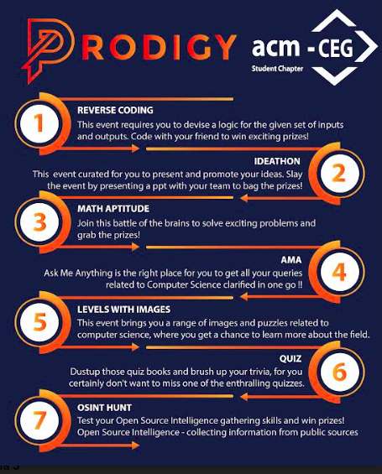
Help from Anna University – ACM Students Chapter
Website: https://auceg.acm.org/index.html
Instagram: https://www.instagram.com/acm_ceg/
Mail id: acmceg2019@gmail.com
Bharath Kumar D P - +91 99520 49834
Asmitha E - +91 73388 50301
Tentative dates of prodigy: 4 October 2022

Slide 9

Thank You

